Slide 1
Definition styles and NLP
Ling7800: Computational Lexical Semantics
Spring 2013

Slide 2
Two main definition types
substitutable (analytic)
  genus word + distinguishing features. Other information may follow. This is the standard in monolingual dictionaries, lexical databases. The origin of “dictionaryese.”
declarative (or “CoBuild” style)
  Best for children or learners. Answers the question “what does X mean?” in a natural way, rather than a “dictionary” way. Closer to natural language than “dictionaryese” and has advantages for NLP.

Slide 3
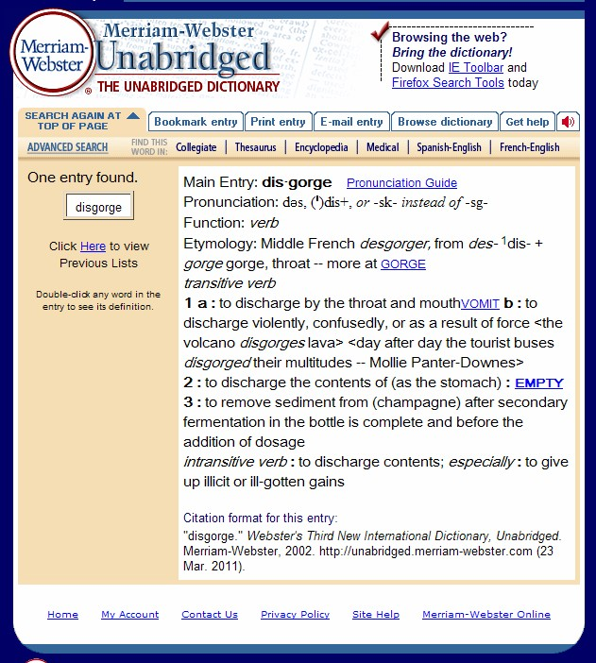
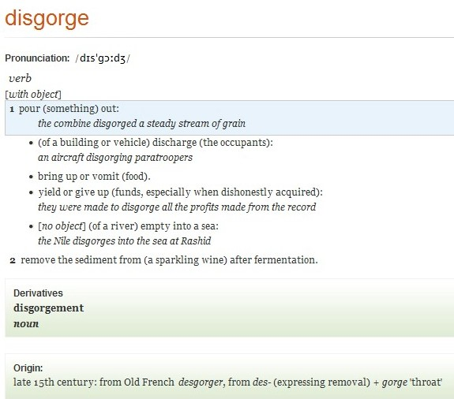
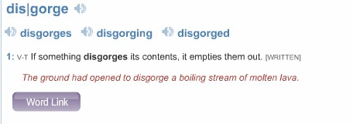

Slide 4
General Guidelines
The definition should be simpler and easier to understand than the word defined
The defined word should not appear in the definition (with some exceptions)
The definition should be a single idea (a dictionary is not an encyclopedia)
(for analytic definitions) The definition must be grammatically equivalent to the part of speech defined
Circularity should be avoided in generic terms

Slide 5
Particular Guidelines
Definitions should fully exploit the range of the user's knowledge (what knowledge do computers have?)
Definitions should fully respect the limitations of the user's knowledge (computers have no “knowledge” aside from what programmers give them)
A dictionary's standard defining style should target the typical user (for NLP this usually means extensive and redundant tagging, linking, mapping within the database)

Slide 6
Defining Language
Mortgage
1. conveyance of the conditional right of ownership (lien) on an asset or property by its owner (the mortgagor) to a lender (the mortgagee) as security for a loan. (www.businessdictionary.com)
2. a conveyance of or lien against property (as for securing a loan) that becomes void upon payment or performance according to stipulated terms (Merrian-Webster Collegiate 11th)
3. an agreement that allows you to borrow money from a bank or similar organization by offering something of value, esp. in order to buy a house or apartment, or the amount of money itself (Cambridge Dictionary of American English)
4. A mortgage is a loan of money which you get from a bank or savings and loan association in order to buy a house. (COBUILD Advanced English Dictionary)

Slide 7
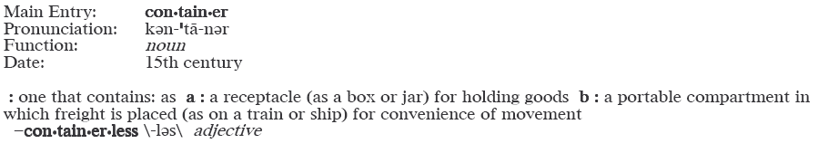
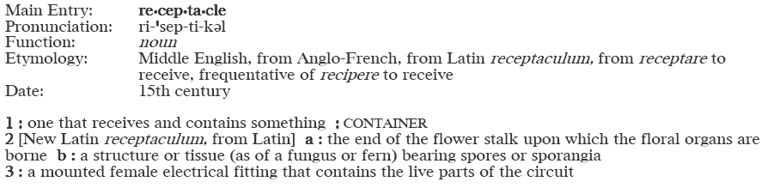
Circularity (harmless)

Slide 8
Circularity (less harmless)
afraid (a·fraid) (uh-frayd)
adjective
1. Frightened; full of fear: I'm afraid of the dark.
2. If you begin or end a sentence with I’m afraid, you show that you are sorry that what you are saying is true: I’m afraid I’m too tired to come visit you.
fear (fear) (feer)
1. noun The feeling you have when you are afraid that something dangerous or bad will happen: I felt fear when I saw the snake.
▷ adjective fearful
2. verb To be afraid of someone or something: Timmy feared the playground bullies.
frighten, frightened (no definitions)

Slide 9
Defining Verbs
Verbs can be defined
with or without the infinitive marker 'to'
according to their transitivity status (transitive, intransitive, ergative, lumped or split)
with reference to limitations of subjects and objects
in NLP, the foregoing are considered under argument structure or valency

Slide 10
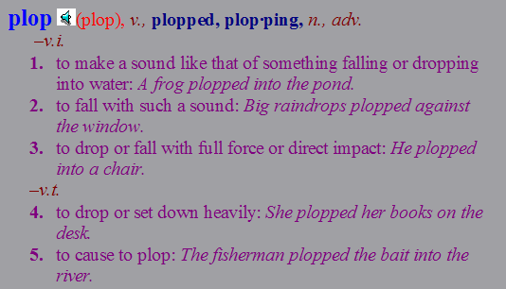
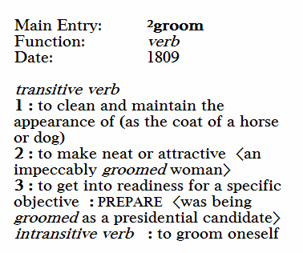
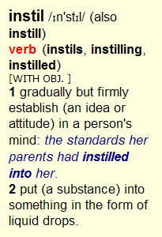
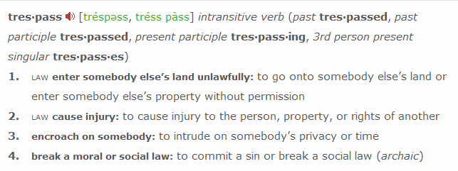

Slide 11
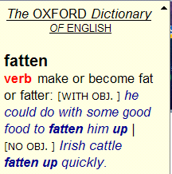
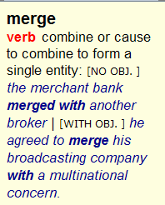
Transitivity matters
Formulas such as “make or become x” (where x is an adjective) and “x or cause to x” (where x is a verb) can be used to lump the transitive and intransitive senses of ergative verbs, provided that the meaning is adequately covered.

Slide 12
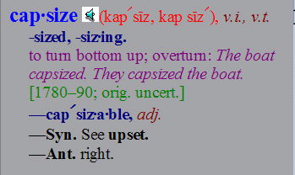
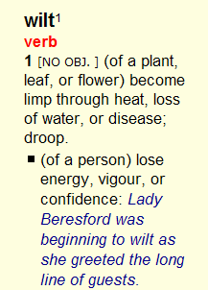
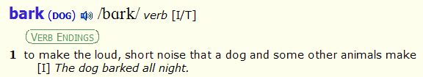
Subject/Object Limitations
Various formulas and
devices indicate to the
user that a verb is only
used with a particular
class of subjects. Standard definitions suggest
limitations to the objects of transitive verbs.

Slide 13
Sense Inventories: who needs 'em?
Raw sense inventories from dictionaries are not suitable for most NLP tasks but may still support WSD when combined with
collocational information (from corpus data)
frame semantics (FrameNet)
verb classification by frame (VerbNet)
WSD by means of conventional inventories may be replaced or supplanted by
extraction of definitions from text (many inherent limitations)
Corpus Pattern Analysis (CPA), based on verbs and the patterns they conventionally instantiate

Slide 14
Disambiguation by Collocation
A large proportion of V+N and N+V collocations resolve to a single sense for each
settle: 22 senses in WordNet, 29 senses in RHUD
  settle the affair/dispute/conflict
  settle the accout/bill/debt
  dust settles
  family/colonists settle
  contents settle
See Just-the-Word.com for clustering of common collocations (based on BNC data)

Slide 15
Disambiguation by Collocation
A large proportion V+N and N+V collocations resolve to a single sense for each
Highly polysemous collocations may represent multiple senses and require further context to disambiguate, e.g.
bring case [V* obj N]:
I didn't have enough evidence to bring the case to court.
letter refer [N* subj V]:
The letters 'c' and 'x' refer to the dilution factor used.

Slide 16
Disambiguation by Collocation
A large proportion V+N and N+V collocations resolve to a single sense for each
Highly polysemous collocations may represent multiple senses and require further context to disambiguate, e.g.
bring case [V* obj N]:
I didn't have enough evidence to bring the case to court.
Her husband Ian brought a case of wine and a box of glasses.
letter refer [N* subj V]:
The letters 'c' and 'x' refer to the dilution factor used.
Michael's letter refers very frequently to 'export-oriented consumed-productivity standards.'

Slide 17
Extracting Definitions from Text
Words defined, glossed, or equated in running text are identifiable by a number of conventional constructions that can be isolated and analyzed.
If/when sentences
“. . . which scientists have dubbed . . .”
“ . . . coined the term X to refer to . . .”
“. . . refer to as . . .”
“. . . is defined as . . .”
“ . . . is/are now called . . .”
“ . . . is said to . . .”

Slide 18
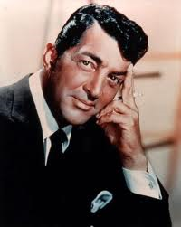
If/When constructions
Text:
“When the moon hits your eye like a big pizza pie, that's amore.”
Extracted definition:
amore=when the moon hits your eye like a big pizza pie.

Slide 19
Productive definition extraction
“A ship is said to miss stays when her head will not fly up into the direction of the wind.” (defines miss stays)
“When we give to, or help others, there is a surge of activity in the brain, which scientists have dubbed a 'helper's high'.” (defines helper's high)
“Selinker(1972) coined the term ‘interlanguage’ to refer to the systematic knowledge of an L2 which is independent of both these learner’s L1 and the target language.” (defines interlanguage)
"outsourcing is defined as the procurement of products and services from sources that are external to the organization (defines outsourcing)
The mandatory sequestration cuts are now called the “St. Patrick’s Day Cliff” in reference to their timing on Congress’ legislative calendar. (defines St. Patrick's Day Cliff)

Slide 20
Corpus Pattern Analysis
Directly relatable to other NLP approaches to the lexicon, such as WordNet, FrameNet, VerbNet. Mainly verb-centric.
Rejects the notion that words have specific meaning independent of context
Links usage to meaning empirically, rather than with reference to a pre-existing inventory
Uses lexicographic methods to devise an NLP-friendly product
A work in progress

Slide 21
CPA Example: one sense of 'grasp'
I. seize hold of something
1. [[Person]] grasp [[PhysObj]] (14%)
implicature: [[Person=Animate]] seizes [[PhysObj]] and holds it firmly.
Lexical alternation: [[Person]] <–> {hand, finger}
other clues: {in [posdet] hand}, {by [det] arm}ex.: He grasped the handle of the door in one hand, and that of the spoon in the other.
2. [[Person 1]] grasp {{[[Person 2]] (by [[BodyPart | Clothing]])} | {[posdet] [[BodyPart | Clothing]]}} (13%)
implicature: [[Person 1=Animate]] seizes [[BodyPart]] or [[Clothing]] of [[Person 2=Animate]]
Lexical alternation: [[Person 1]] <–> {hand, finger}

